Slide 1
ENGAGING COMMUNITY ON ENGAGEMENT
Developing the Township’s Community Engagement Strategy Project Update

Slide 2
Agenda
Welcome and Connection
Definition of Community Engagement
Understanding the Project
Considerations for Engagement
Your Feedback
Close

Slide 3
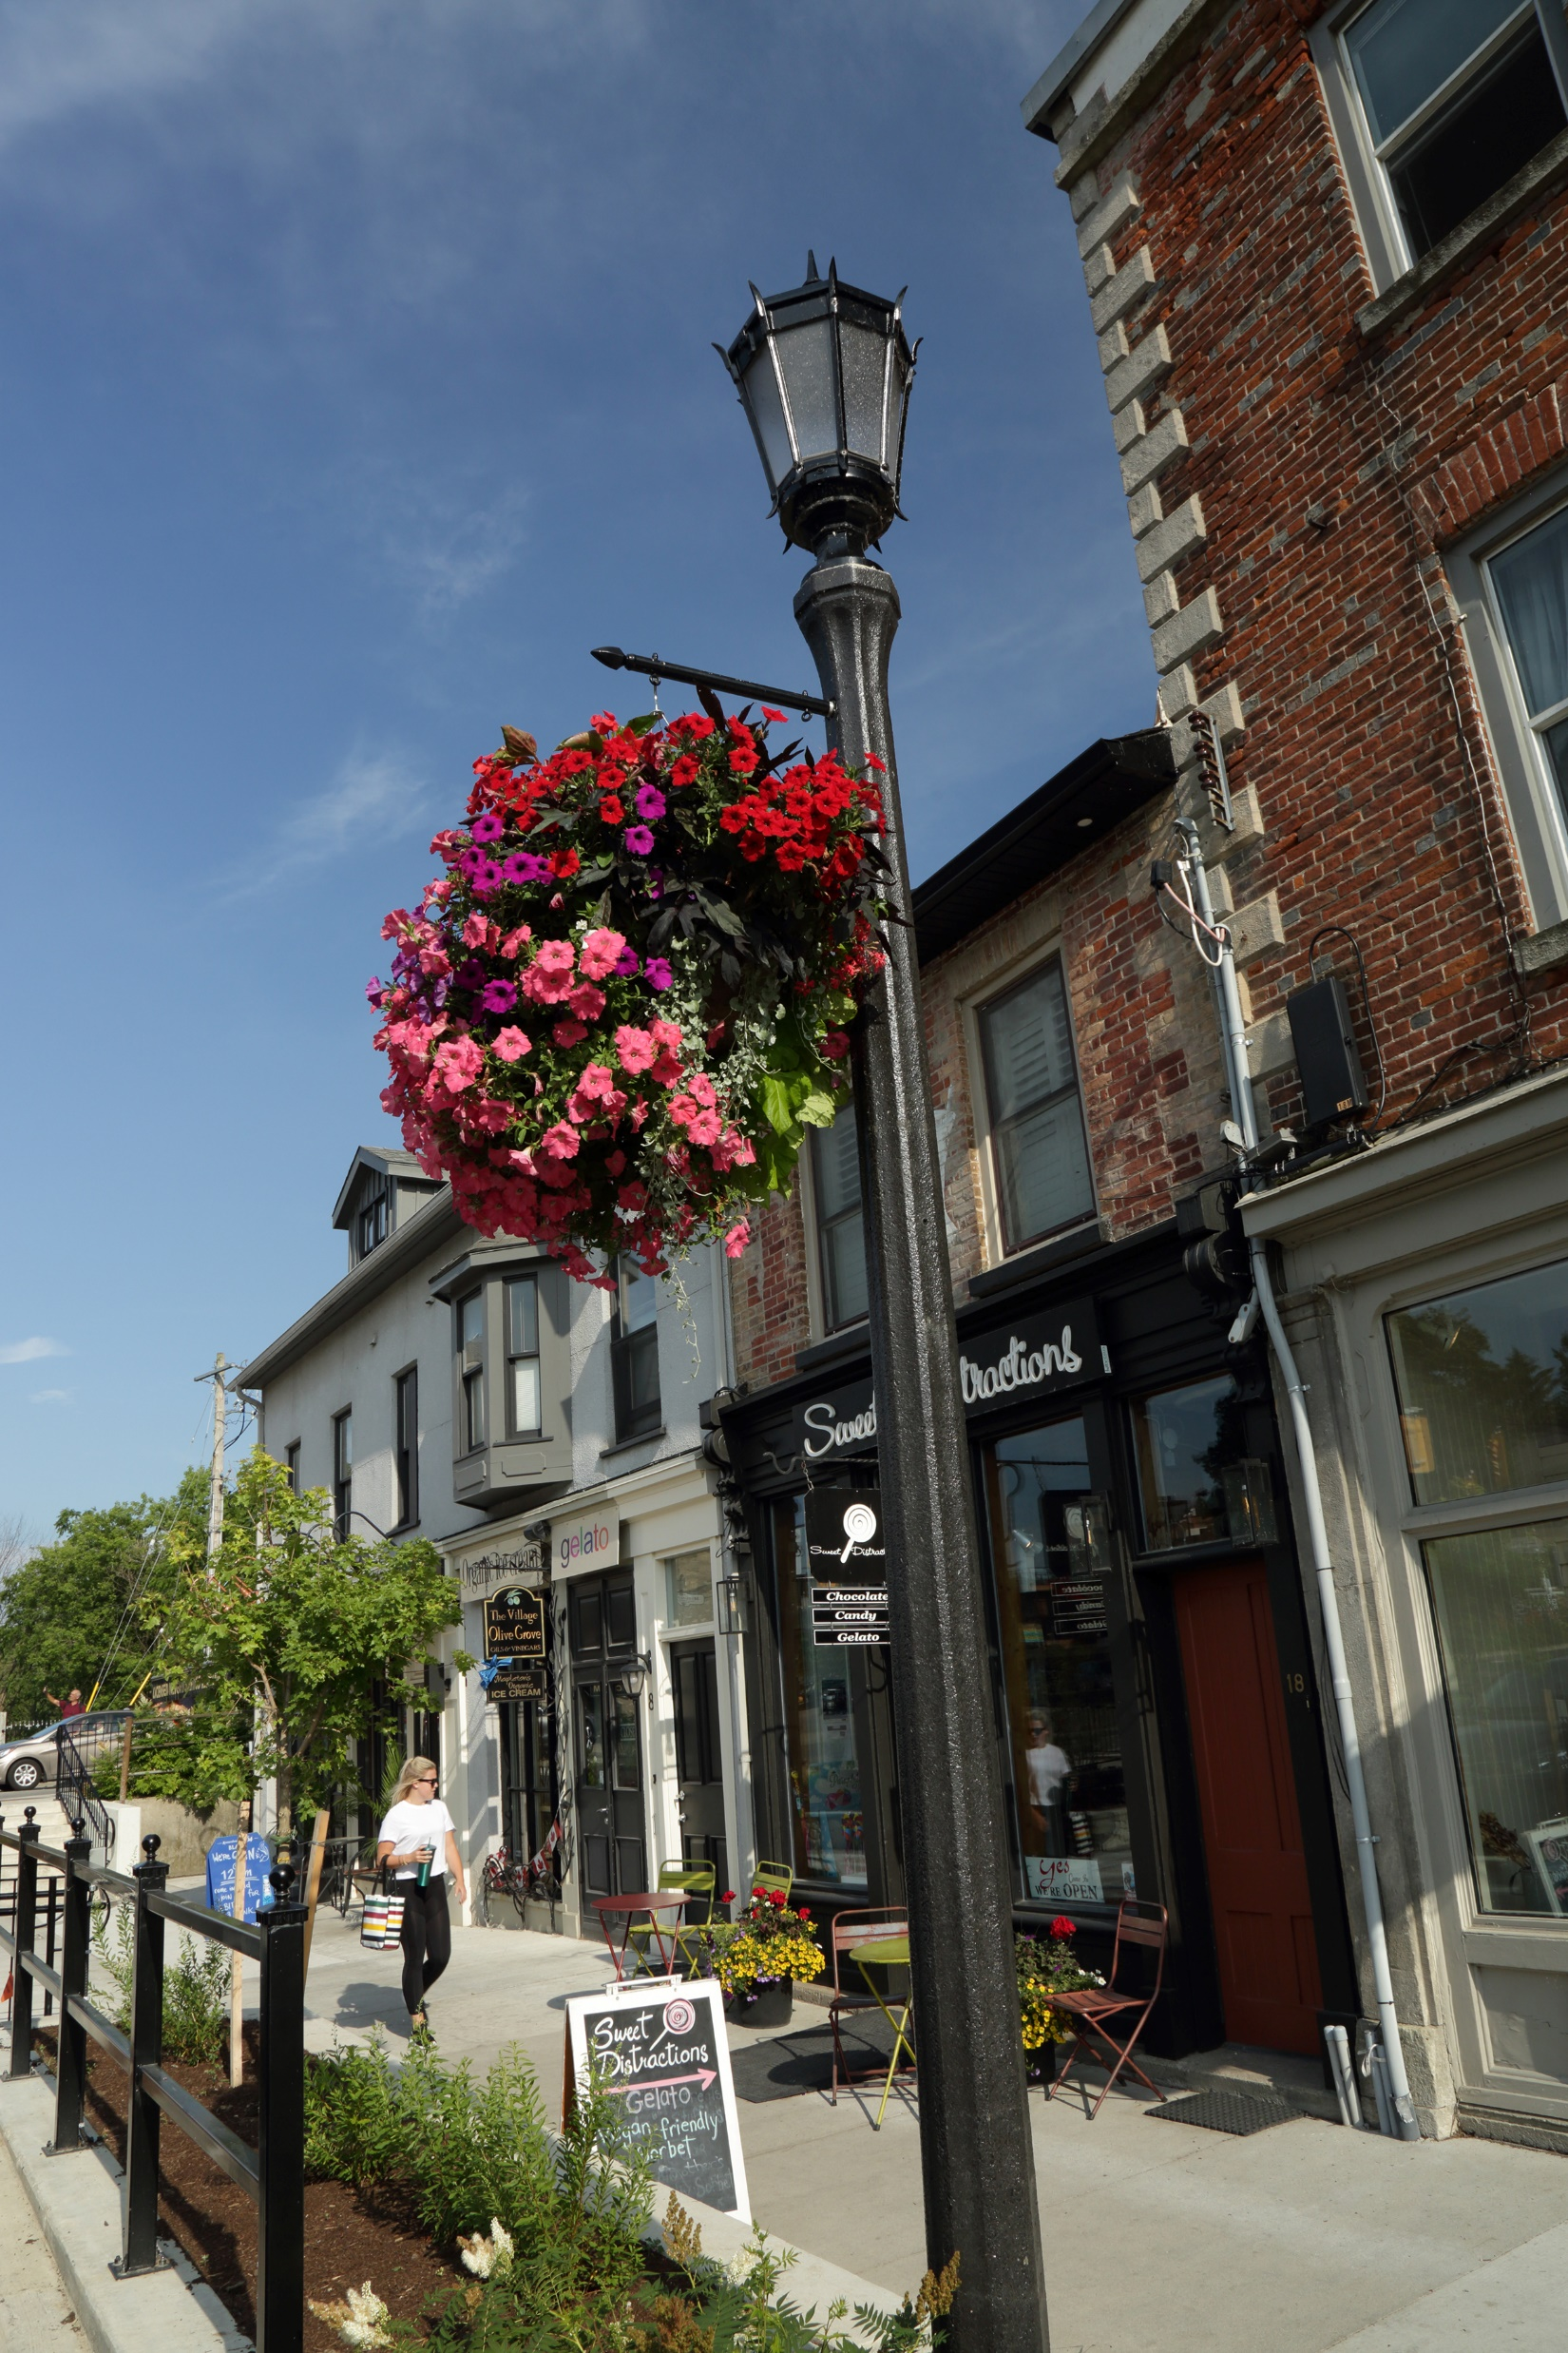
Community Engagement
Is defined as:
“An intentional process with the purpose of working in inclusive and respectful ways to shape decisions, actions, impacts, or change. It is:
Purposeful and goal driven,
Trust and relationship focused,
Values based and people centered,
Inclusive and equity centered, and
Impact and outcome oriented.”
- The International Association of Public Participation (IAP2)

Slide 4
Current State
The Township regularly engages with our community on a variety of issues.
Currently, we have no policy, strategy, framework, or tools to guide our practice.
We have achieved some success in the past and know we can improve.
Community engagement can contribute significantly to supporting the Township’s vision of being an active, caring, innovative, safe, and connected community.

Slide 5
The Project
The primary goals of the project are to:
Establish a robust and transparent community engagement program.
Foster trust and relationship building within the community.
Ensure inclusivity in decision-making.
Establish a positive culture of engagement.

Slide 6
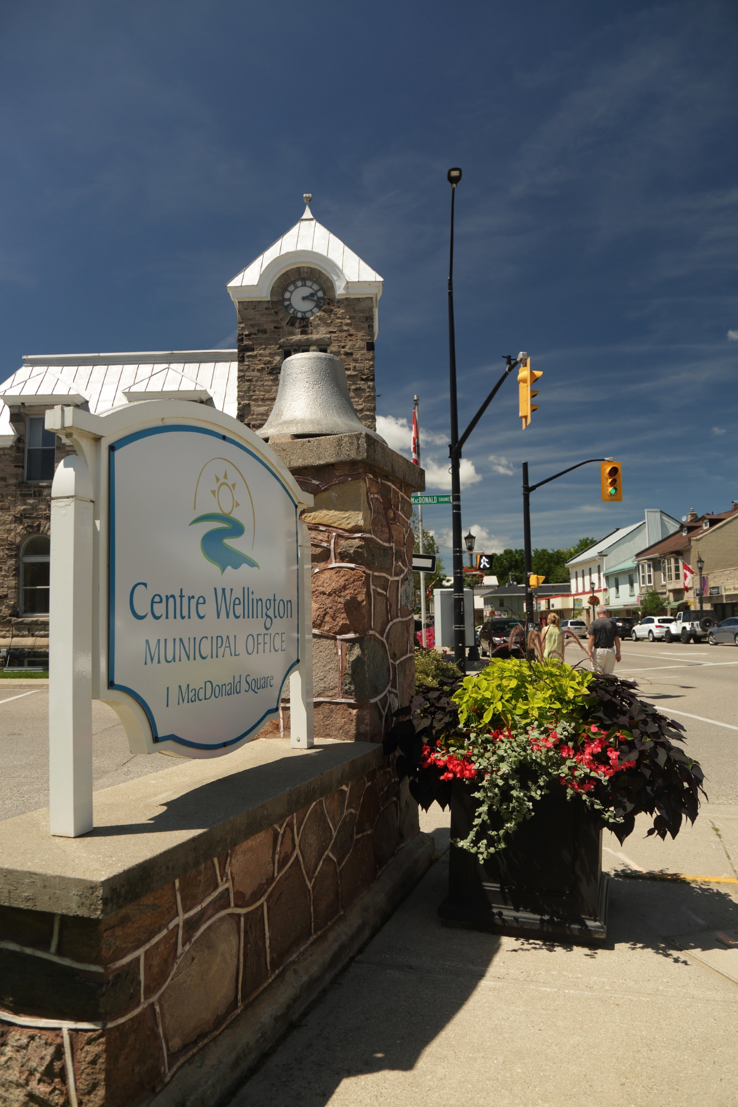
Project Deliverables
Our upcoming engagement process will inform the development of:
CE Strategy – outlines the consistent, proactive, inclusive, and meaningful way the Township will engage the community.
Action Plan – roadmap for Administration to implement the CE strategy.
Staff Toolkit and Templates – tools and guidance for staff from access the organization to use to bring the CE Strategy to life.
CE Charter – outlining the commitment, responsibilities, and core principles of engagement between the Township, Council, and residents.

Slide 7
Inputs to Decision Making

Slide 8
The Decision Makers

Slide 9
Project Timelines

Slide 10
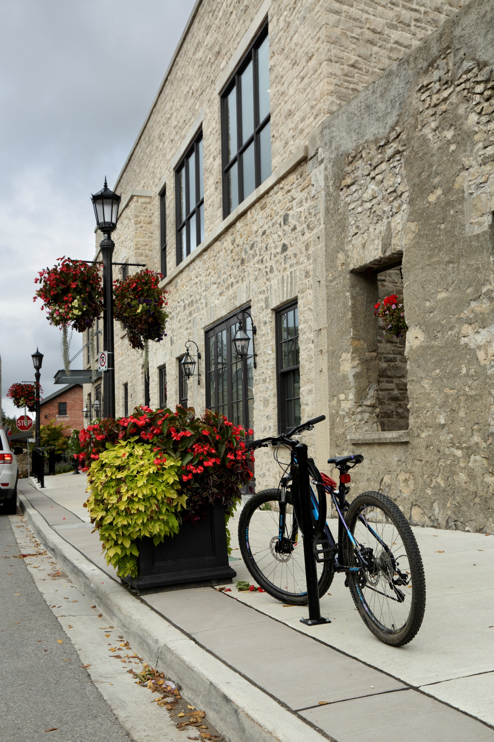
Plan + Prepare
To help us develop the engagement plan, we’re seeking input from:
Township’s Community Engagement Working Group
1:1 interviews with community members (representing those new to the community, those new to Canada, youth, 2SLGBTQIA+, visible minorities, those providing services to those living in poverty, Indigenous Peoples, seniors, not-for-profit housing, and business community)
Survey with Mayor and Council
Survey with Senior Management Team
Township’s DEI and Healthy Communities Advisory Committees

Slide 11
Initial Thoughts on Engagement
Will be developing an equity lens to apply to this project.
Pop-up in locations through the Township where people are already going.
Offer a variety of opportunities for people to choose how to participate.
Offer online and in-person activities.
Hold coffee chats in cafés, restaurants, and other venues.
Offer events targeted specifically to those voices often missed – workshop or drop-in style, family friendly.
Find community partners to host or co-host events.
Engage with Township staff.

Slide 12
Discussion Questions
Please complete the following statement –
“This engagement process with the Township will be a success if…”
What would an inclusive process look like? How can we address barriers?
What are the best ways to reach people to invite them to participate and inform them about this project?
What do you see as your role in this project? How would you like to be involved?
What other guidance or advice do you have for us?

