Slide 1
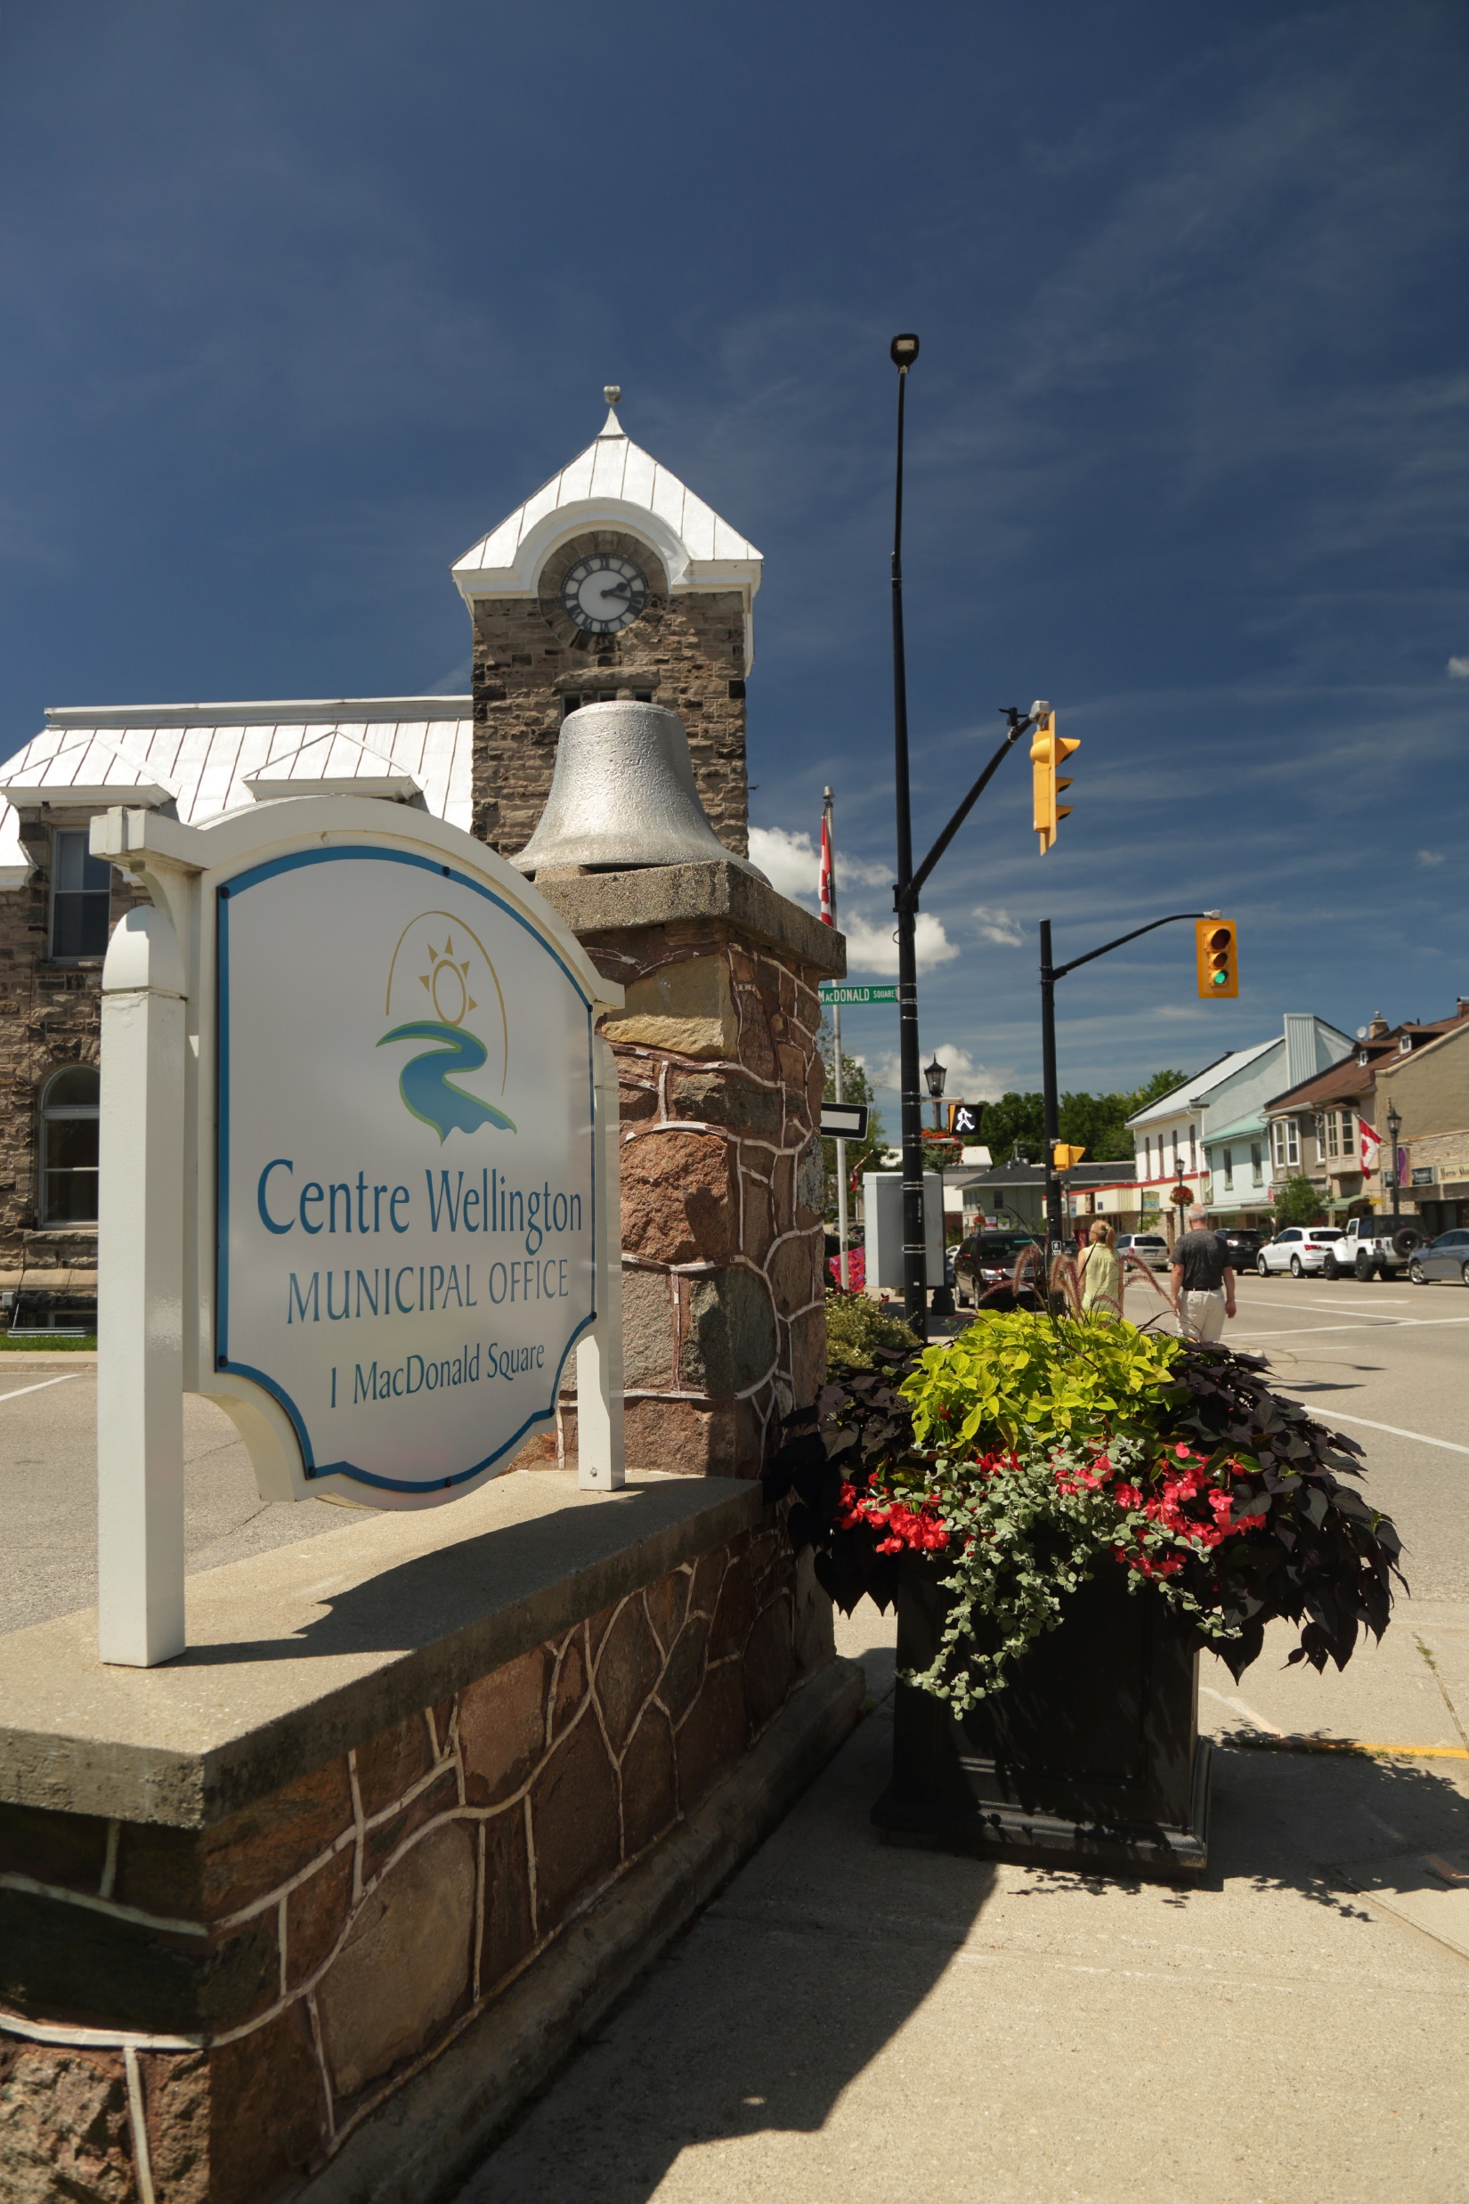
Belwood Hall
Renovation Update
Kasey Beirnes – Manager of Buildings and Properties
May 14th, 2025

Slide 2
Agenda
Vision/Purpose
Project Overview
Concept Design
Community Engagement
Community Feedback
Schematic Design Progress
Pricing/Budget
Next Steps

Slide 3
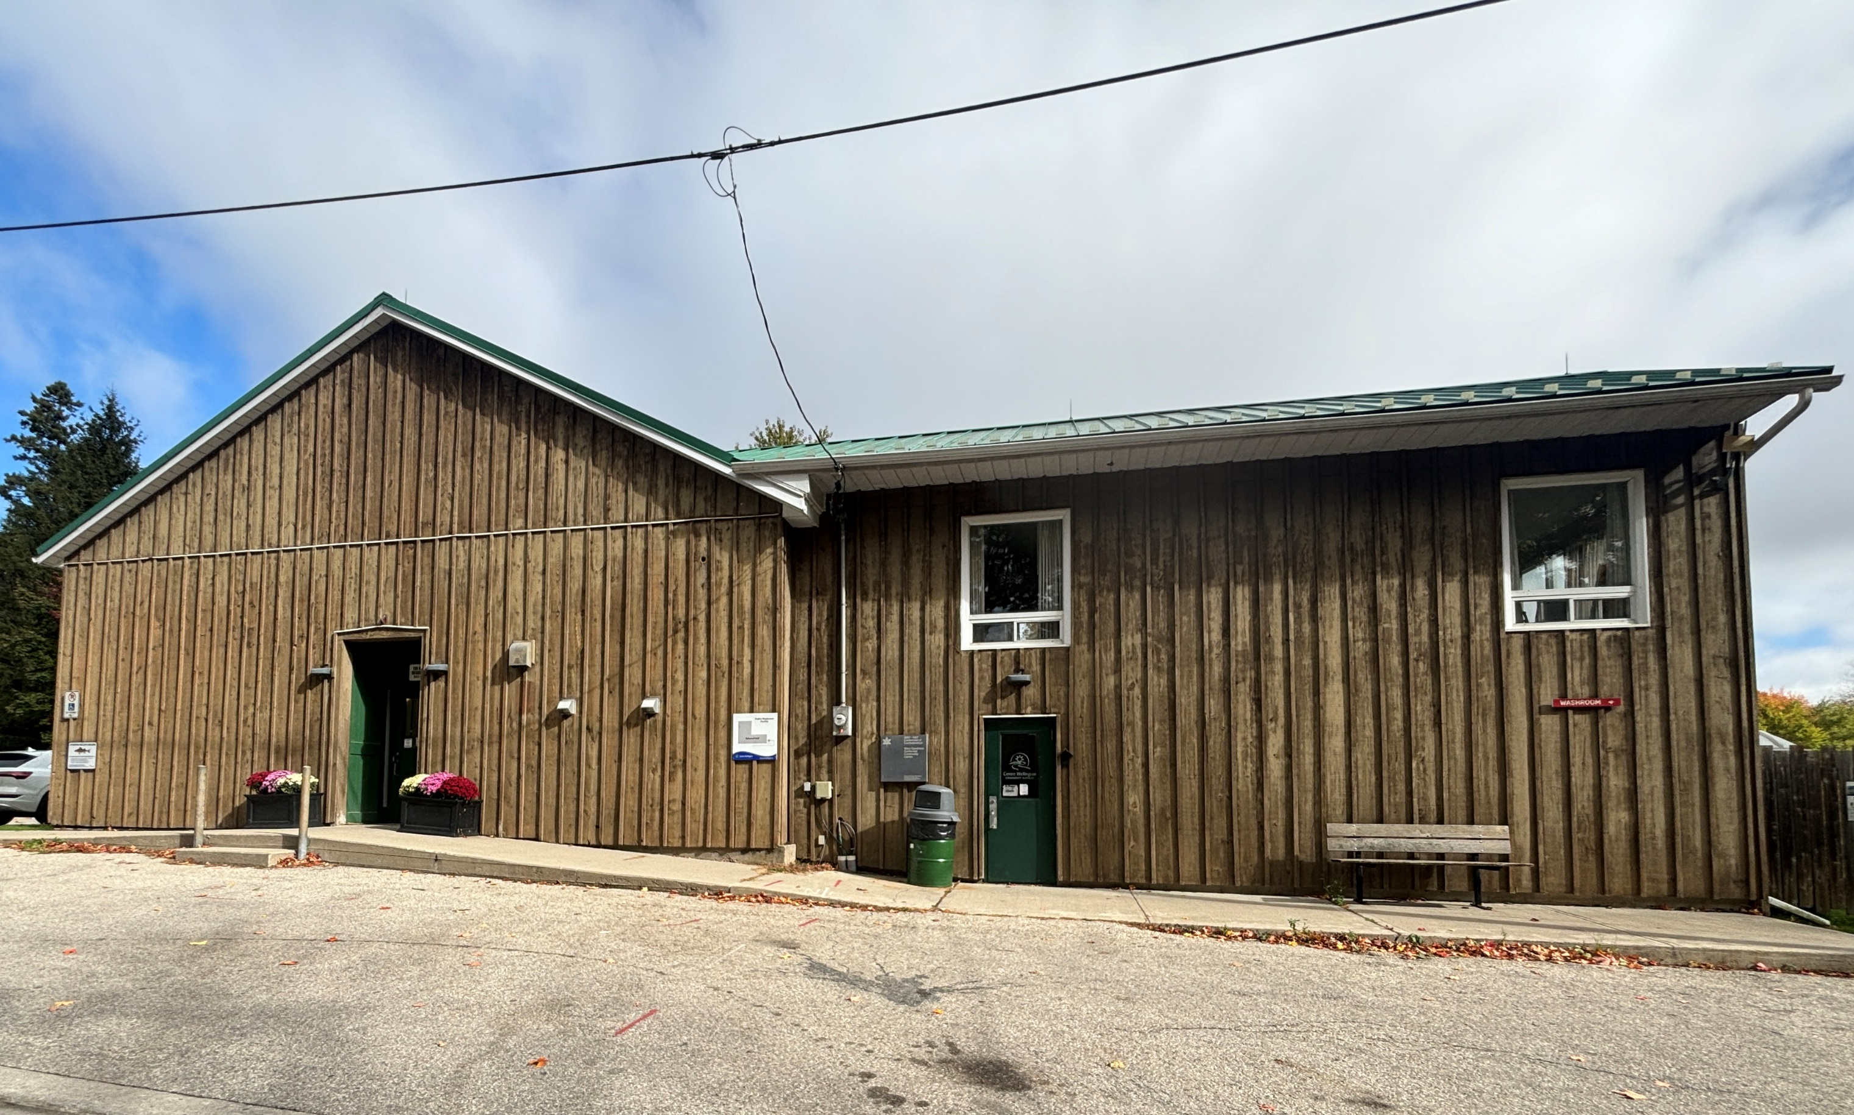
Vision/Purpose
Vision
Enhance the sense of community through an inclusive, accessible gathering space.
A revitalized, safe and usable hub for the community.
Designed with the community, for the community
Community Benefits
Inclusion & Accessibility – Fully accessible space ensures everyone can use and participate.
Multi-use flexibility – Birthday parties, family reunions, meetings, programing etc.
Economic Increase – Attraction of events, rentals, and activities
Importance of small-town vitality
3 | Belwood Hall Renovation
Notes:
Our mission goes far beyond physical upgrades. This project is about building belonging. It’s about ensuring that every resident—regardless of age, ability, income, or background—has a place they can access, enjoy, and feel proud of.
From kids’ camps to seniors’ socials, cultural showcases to town meetings—this revitalized space will meet real, everyday needs. It will support mental health, reduce isolation, spark creativity, and create opportunities for economic and social growth in our community.
We’re designing not just a building, but a vibrant, welcoming environment that reflects our community’s values and future potential."

Slide 4
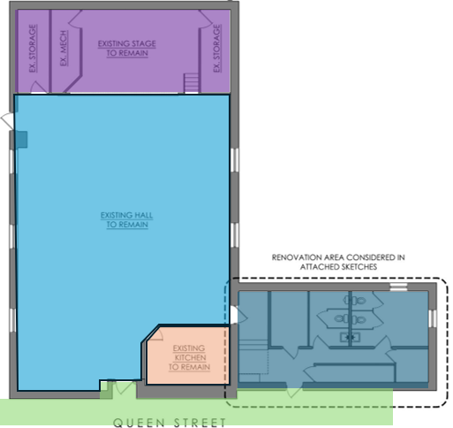
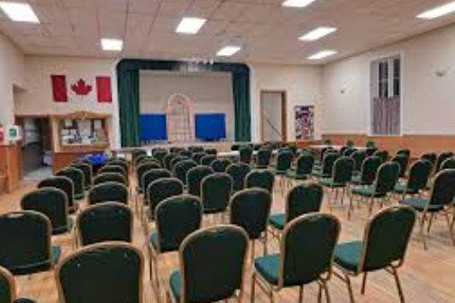
Project Overview
Project Areas
Washroom Area
Kitchen/Servery
Front Entrance
Assembly Hall/ Stage Area
Septic System
4 | Belwood Hall Renovation
Notes:
Our Phase 1 plan focuses on five key areas. These upgrades will improve not only how the space functions but also how people feel when they use it. From modern accessible washrooms to a welcoming entrance and a fully functional kitchen, each piece plays a role in making this a true community hub."

Slide 5
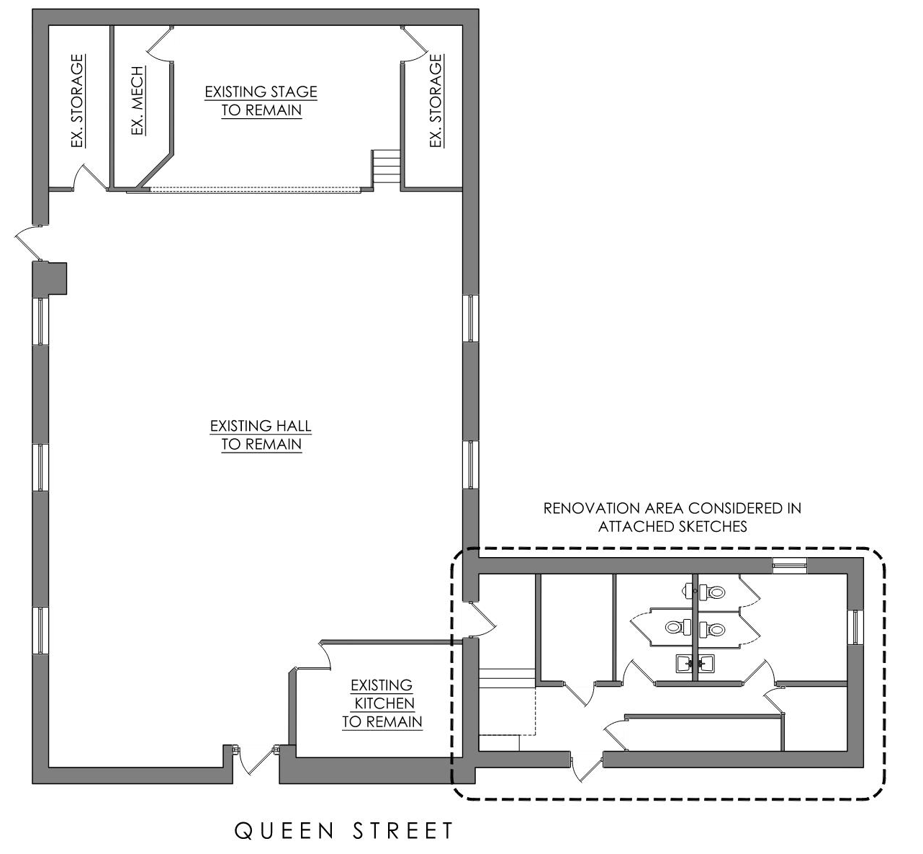
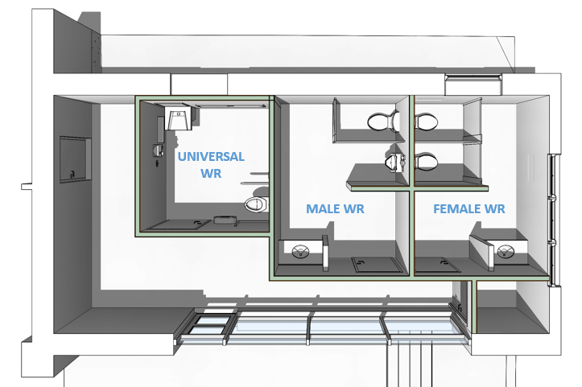
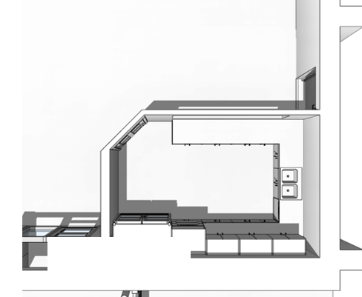
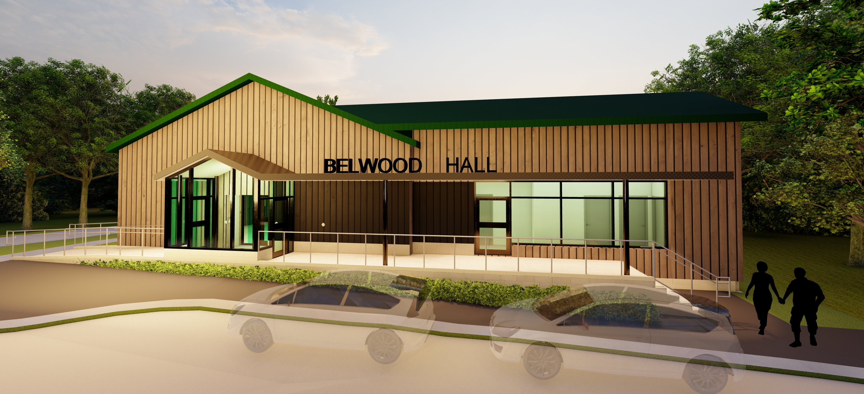
Conceptual Design
WASHROOM AREA
ASSEMBLY HALL & STAGE AREA
KITCHEN
ENTRANCE

Slide 6
Community Engagement
Engagement Sessions
Belwood Hall Town Hall Meeting
Fergus Lions Club
County Joint Accessibility Committee
HCAC (Healthy Community Advisory Committee)
DEI (Diversity Equity Inclusion)
Community Services – Team Meeting
Township Interdepartmental Meeting
Connect CW – Online Platform
Belwood Community Meeting
6 | Belwood Hall Renovation

Slide 7
Community Feeback
Ventilation &
Air Conditioning
Storage
Program Space
Water bottle fill station
Public Washroom Access
COMMUNITY
Loop – Hearing assistant
Kitchen
Update
Accessible
AV Update
7 | Belwood Hall Renovation

Slide 8
Schematic Design
Schematic Design Images
8 | Belwood Hall Renovation

Slide 9
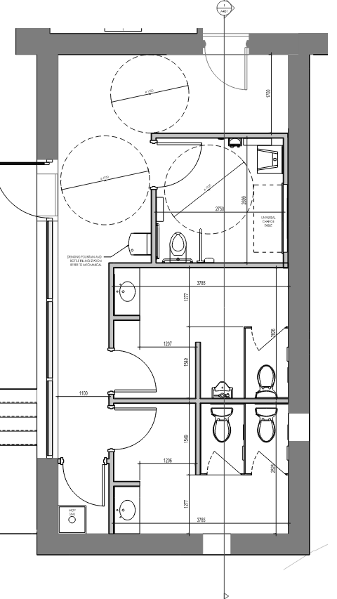
Schematic Design
Washroom Area
Raised Floor
Universal washroom
Push button operators
Entrance Doors
Universal Washroom
Barrier free travel
Frosted glass
Water fill station
Ventilation
HVAC

Slide 10
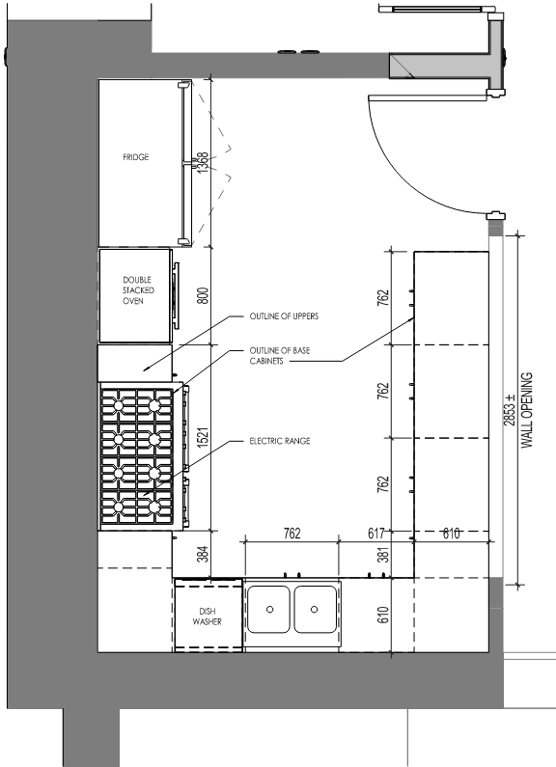
Schematic Design
Severy Kitchen Area
Electric Range
Double Fridge
Full Sanitary Kitchen
Dishwasher (Optional)
Entrance Adjustment
Cabinetry
Lockable cabinets
Warming Ovens
Sanitary Kitchen (Handwash Sink)
10 | Belwood Hall Renovation

Slide 11
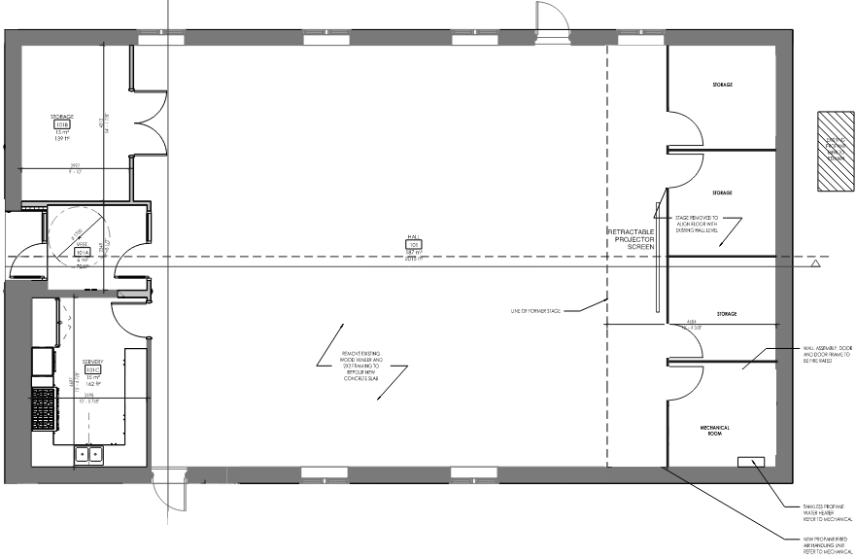
Schematic Design
Assembly Hall & Stage Area
Entrance Vestibule
Full Floor Removal
Polished Concrete Floors or VCT Tile
Lighting Upgrade
Stage Removal
Increased Storage
Removal of Bench Seating
Mechanical System
ERV – Ventilation
On Demand Domestic Hot Water System
Propane Fired Air Handler or VRF (Variable Refrigerant Flow)
Foundation Condition
Additional Items
AV Equipment
Window replacement
11 | Belwood Hall Renovation

Slide 12
Schematic Design
Septic System
Additional Fixtures:
Universal Washroom
Sink
Urinal
Toilet
Water Fountain
Handwash Sink
Dishwasher
ATA Architects are coordinating a site-specific septic review to confirm whether the current system is adequately sized for the proposed design.
12 | Belwood Hall Renovation

Slide 13
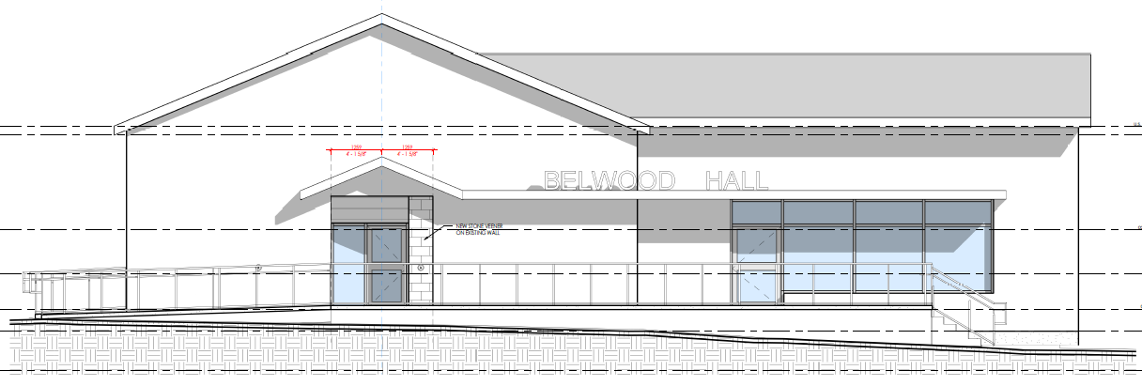
Schematic Design
Main Hall & Washroom Entrance

Slide 14
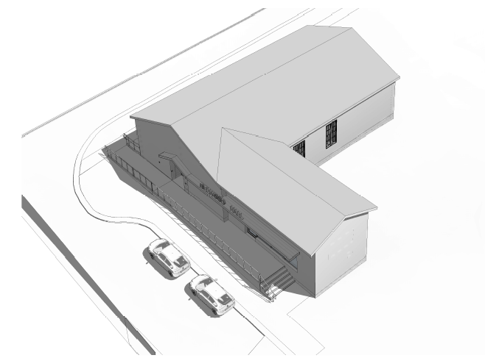
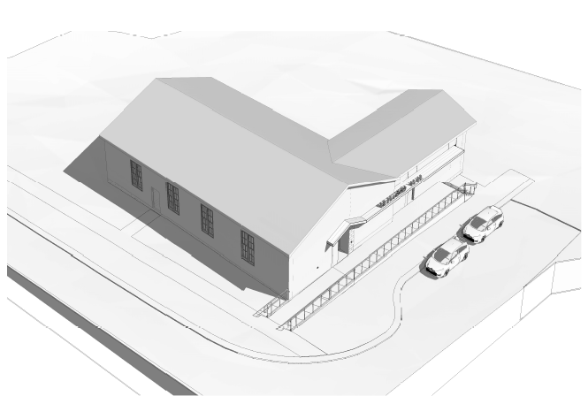
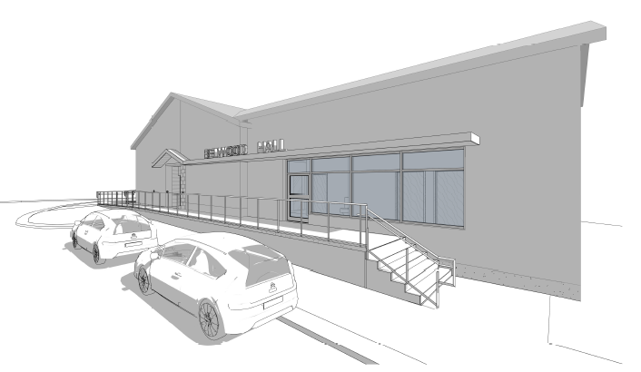
Schematic Design
Exterior Renderings

Slide 15
Pricing/Budget
Total Project Funding: $850,000
Schematic drawings: Complete
Cost Estimate Status: In progress, Area Breakdown
External Funding: No external funding has been received to date
15 | Belwood Hall Renovation

Slide 16
Current Stage & Next Steps
Milestone | Date/Status
Community Engagement | Complete
Schematic Design Received | Complete
Structural Preliminary Review Complete | Complete
Mechanical & Electrical Preliminary Review | Complete
Geotechnical Investigation | Complete – Results Pending
Class D Pricing Received | In Progress
Council – Presentation | June 2025
Detailed Design Finalization | Fall 2025
Procurement Tender & Award | Winter 2025
Construction | 2026
Grand Opening | 2026

Slide 17
Conclusion

Slide 18
Contact Information
Kasey Beirnes - Manager of Buildings & Properties
email: KBeirnes@centrewellington.ca
phone: +1 (519) 846-9691 x 333
Mason Noble – Capital Projects Manager
email: mnoble@centrewellington.ca
phone: +1 (519) 846-9691 x 258

